Slide 1
Statistics for
Business and Economics 8th Edition
Chapter 16
Time-Series Analysis and Forecasting

Slide 2
Chapter Goals
After completing this chapter, you should be able to:
Identify the trend, seasonality, cyclical, and irregular components in a time series
Use smoothing-based forecasting models, including moving average and exponential smoothing
Apply autoregressive models and autoregressive integrated moving average models

Slide 3
Introduction
Time-Series Data
Numerical data ordered over time
The time intervals can be annually, quarterly, daily, hourly, etc.
The sequence of the observations is important
Example:
Year: 2008 2009 2010 2011 2012
Sales: 75.3 74.2 78.5 79.7 80.2

Slide 4
Components of a Time Series
16.1
Time Series
Trend Component
Seasonality Component
Cyclical Component
Irregular Component

Slide 5
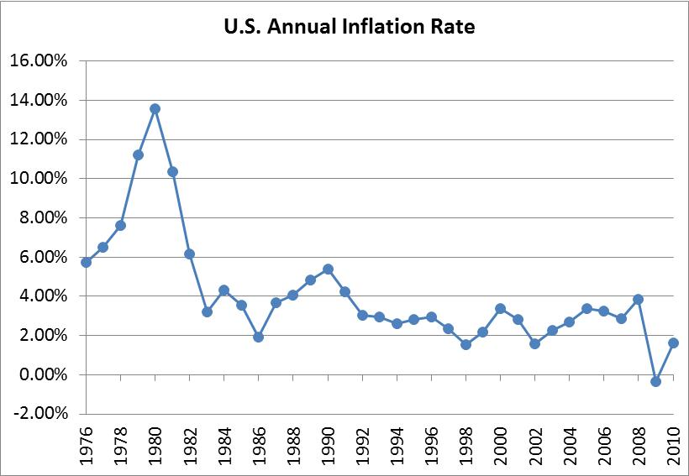
Time-Series Plot
A time-series plot is a two-dimensional plot of time-series data
the vertical axis measures the variable of interest
the horizontal axis corresponds to the time periods

Slide 6
Trend Component
Long-run increase or decrease over time (overall upward or downward movement)
Data taken over a long period of time
Sales
Upward trend
Time

Slide 7
Trend Component
(continued)
Trend can be upward or downward
Trend can be linear or non-linear
Sales
Sales
Time
Time
Downward linear trend
Upward nonlinear trend

Slide 8
Seasonal Component
Short-term regular wave-like patterns
Observed within 1 year
Often monthly or quarterly
Year n+1
Year n
Sales
Summer
Winter
Summer
Winter
Spring
Fall
Spring
Fall
Time (Quarterly)

Slide 9
Cyclical Component
Long-term wave-like patterns
Regularly occur but may vary in length
Often measured peak to peak or trough to trough
1 Cycle
Sales
Year

Slide 10
Irregular Component
Unpredictable, random, “residual” fluctuations
Due to random variations of
Nature
Accidents or unusual events
“Noise” in the time series

Slide 11
Time-Series Component Analysis
Used primarily for forecasting
Observed value in time series is the sum or product of components
Additive Model
Multiplicative model (linear in log form)
where X_{t} = value of the time series at time t
T_{t} = Trend component at period t
S_{t} = Seasonality component for period t
C_{t} = Cyclical component at time t
I_{t} = Irregular (random) component for period t

Slide 12
Moving Averages
16.2
Calculate moving averages to get an overall impression of the pattern of movement over time
This smooths out the irregular component
Moving Average: averages of a designated
number of consecutive
time-series values

Slide 13
(2m+1)-Point Moving Average
A series of arithmetic means over time
Result depends upon choice of m (the number of data values in each average)
Examples:
For a 5 year moving average, m = 2
For a 7 year moving average, m = 3
Etc.
Replace each x_{t} with

Slide 14
Moving Averages
Example: Five-year moving average
First average:
Second average:
etc.

Slide 15
Example: Annual Data
Year | Sales
1 2 3 4 5 6 7 8 9 10 11 etc… | 23 40 25 27 32 48 33 37 37 50 40 etc…
…
…

Slide 16
Calculating Moving Averages
Let m = 2
Average Year | 5-Year Moving Average
3 | 29.4
4 | 34.4
5 | 33.0
6 | 35.4
7 | 37.4
8 | 41.0
9 | 39.4
… | …
Year | Sales
1 | 23
2 | 40
3 | 25
4 | 27
5 | 32
6 | 48
7 | 33
8 | 37
9 | 37
10 | 50
11 | 40
etc…
Each moving average is for a consecutive block of (2m+1) years

Slide 17
Annual vs. Moving Average
The 5-year moving average smoothes the data and shows the underlying trend

Slide 18
Centered Moving Averages
Let the time series have period s, where s is even number
i.e., s = 4 for quarterly data and s = 12 for monthly data
To obtain a centered s-point moving average series X_{t}*:
Form the s-point moving averages
Form the centered s-point moving averages

Slide 19
Centered Moving Averages
Used when an even number of values is used in the moving average
Average periods of 2.5 or 3.5 don’t match the original periods, so we average two consecutive moving averages to get centered moving averages
Average Period | 4-Quarter Moving Average
2.5 | 28.75
3.5 | 31.00
4.5 | 33.00
5.5 | 35.00
6.5 | 37.50
7.5 | 38.75
8.5 | 39.25
9.5 | 41.00
Centered Period | Centered Moving Average
3 | 29.88
4 | 32.00
5 | 34.00
6 | 36.25
7 | 38.13
8 | 39.00
9 | 40.13
etc…

Slide 20
Seasonal Index Method
Goal: estimate the seasonal impact
Assume a stable seasonal pattern over time
For any month or quarter in each year, the effect of seasonality is to increase or decrease the series by the same percentage
Divide the actual sales value by the centered moving average for that period

Slide 21
Calculating a Seasonal Index
Quarter | Sales | Centered Moving Average | Ratio-to-Moving Average
1 2 3 4 5 6 7 8 9 10 11 … | 23 40 25 27 32 48 33 37 37 50 40 … | 29.88 32.00 34.00 36.25 38.13 39.00 40.13 etc… … … | 83.7 84.4 94.1 132.4 86.5 94.9 92.2 etc… … …

Slide 22
Calculating a Seasonal Index
(continued)
Quarter | Sales | Centered Moving Average | Ratio-to-Moving Average
1 2 3 4 5 6 7 8 9 10 11 … | 23 40 25 27 32 48 33 37 37 50 40 … | 29.88 32.00 34.00 36.25 38.13 39.00 40.13 etc… … … | 83.7 84.4 94.1 132.4 86.5 94.9 92.2 etc… … …
Fall
Find the median of all of the same-season values
Adjust so that the average over all seasons is 100
Fall
Fall

Slide 23
Interpreting Seasonal Indexes
Suppose we get these seasonal indexes:
Season | Seasonal Index
Spring | 0.825
Summer | 1.310
Fall | 0.920
Winter | 0.945
Interpretation:
Spring sales average 82.5% of the annual average sales
Summer sales are 31.0% higher than the annual average sales
etc…
Σ = 4.000 -- four seasons, so must sum to 4

Slide 24
Exponential Smoothing
16.3
A weighted moving average
Weights decline exponentially
Most recent observation weighted most
Used for smoothing and short term forecasting (often one or two periods into the future)

Slide 25
Exponential Smoothing
(continued)
The weight (smoothing coefficient) is α
Subjectively chosen
Range from 0 to 1
Smaller α gives more smoothing, larger α gives less smoothing
The weight is:
Low value (closer to 0) for smoothing out unwanted cyclical and irregular components
Higher value (closer to 1) for forecasting, especially for smoother time series

Slide 26
Exponential Smoothing Model
1. Obtain the smoothed series:
2. From time n, the forecasts of future values are
where:
= exponentially smoothed value for period t
= exponentially smoothed value already
computed for period i - 1
x_{t} = observed value in period t
α = weight (smoothing coefficient), 0 < α < 1

Slide 27
Exponential Smoothing Example
Suppose we use weight α = 0.2
Time Period (t) | Sales (X_{t}) | Forecast from prior period ( ) | Exponentially Smoothed Value for this period ( )
1 2 3 4 5 6 7 8 9 10 etc. | 23 40 25 27 32 48 33 37 37 50 etc. | -- 23 26.4 26.12 26.296 27.437 31.549 31.840 32.872 33.697 etc. | 23 (.8)(23)+(.2)(40)=26.4 (.8)(26.4)+(.2)(25)=26.12 (.8)(26.12)+(.2)(27)=26.296 (.8)(26.296)+(.2)(32)=27.437 (.8)(27.437)+(.2)(48)=31.549 (.8)(31.549)+(.2)(33)=31.840 (.8)(31.840)+(.2)(37)=32.872 (.8)(32.872)+(.2)(37)=33.697 (.8)(33.697)+(.2)(50)=36.958 etc.
= x₁ since no prior information exists

Slide 28
Sales vs. Smoothed Sales
Fluctuations have been smoothed
NOTE: the smoothed value in this case is generally a little low, since the trend is upward sloping and the weighting factor is only 0.2

Slide 29
Forecasting Time Period (t + 1)
The smoothed value in the current period (t) is used as the forecast value for next period (t + 1)
Standing at time n, we obtain the forecasts of future values, X_{n+h} of the series

Slide 30
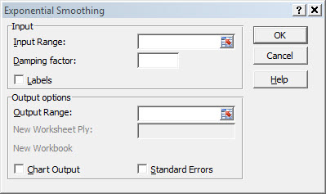
Exponential Smoothing in Excel
Use Data / Data Analysis /
exponential smoothing
The “damping factor” is (1 - α)

Slide 31
Holt-Winters Exponential Smoothing Forecasting Model
To perform the Holt-Winters method of forecasting:
Obtain estimates of level and trend T_{t} as
Where α and β are smoothing constants whose values are fixed between 0 and 1
Standing at time n , we obtain the forecasts of future values, X_{n+h} of the series by

Slide 32
Forecasting Seasonal Time Series
Assume a seasonal time series of period s
The Holt-Winters method of forecasting uses a set of recursive estimates from the historical series
These estimates utilize a level factor, α, a trend factor, β, and a multiplicative seasonal factor, γ

Slide 33
Forecasting Seasonal Time Series
(continued)
The recursive estimates are based on the following equations
Where is the smoothed level of the series, T_{t} is the smoothed trend of the series, and F_{t} is the smoothed seasonal adjustment for the series

Slide 34
Forecasting Seasonal Time Series
(continued)
After the initial procedures generate the level, trend, and seasonal factors from a historical series we can use the results to forecast future values h time periods ahead from the last observation X_{n} in the historical series
The forecast equation is
where the seasonal factor, F, is the one generated for the most recent seasonal time period

Slide 35
Autoregressive Models
16.4
Used for forecasting
Takes advantage of autocorrelation
1st order - correlation between consecutive values
2nd order - correlation between values 2 periods apart
p^{th} order autoregressive model:
Random Error

Slide 36
Autoregressive Models
(continued)
Let X_{t} (t = 1, 2, . . ., n) be a time series
A model to represent that series is the autoregressive model of order p:
where
γ, φ₁ φ₂, . . .,φ_{p} are fixed parameters
ε_{t} are random variables that have
mean 0
constant variance
and are uncorrelated with one another

Slide 37
Autoregressive Models
(continued)
The parameters of the autoregressive model are estimated through a least squares algorithm, as the values of γ, φ₁ φ₂, . . .,φ_{p} for which the sum of squares
is a minimum

Slide 38
Forecasting from Estimated Autoregressive Models
Consider time series observations x₁, x₂, . . . , x_{t}
Suppose that an autoregressive model of order p has been fitted to these data:
Standing at time n, we obtain forecasts of future values of the series from
Where for h > 0, is the forecast of X_{t+h} standing at time n and for h ≤ 0 , is simply the observed value of X_{t+h}

Slide 39
Autoregressive Model: Example
The Office Concept Corp. has acquired a number of office units (in thousands of square feet) over the last eight years. Develop the second order autoregressive model.
Year Units
2005 4
2006 3
2007 2
2008 3
2009 2
2010 2
2011 4
2012 6

Slide 40
Autoregressive Model: Example Solution
Develop the 2nd order table
Use Excel to estimate a regression model
Year x_{t} x_{t-1} x_{t-2}
2005 4 -- --
2006 3 4 --
2007 2 3 4
2008 3 2 3
2009 2 3 2
2010 2 2 3
2011 4 2 2
2012 6 4 2
Excel Output

Slide 41
Autoregressive Model Example: Forecasting
Use the second-order equation to forecast number of units for 2013:

Slide 42
Autoregressive Modeling Steps
Choose p
Form a series of “lagged predictor” variables x_{t-1} , x_{t-2} , … ,x_{t-p}
Run a regression model using all p variables
Test model for significance
Use model for forecasting

Slide 43
Autoregressive Integrated Moving Average Models
16.5
General idea of Box-Jenkins methodology:
Define a broad class of models from which forecasts can be derived
Develop a methodology for picking a suitable model for the forecasting problem
The general class of models is the class of autoregressive integrated moving average models, or ARIMA models
These are natural extensions of the autoregressive models of Section 16.4

Slide 44
Box-Jenkins Methodology
The Box-Jenkins methodology involves three stages:
Use summary statistics from the available data to select a specific model that might be appropriate from the general class
The specific model chosen will have some unknown coefficients. These must be estimated from the available data using techniques such as least squares
Checks are applied to determine whether the estimated model provides an adequate representation of the available time-series data

Slide 45
Box-Jenkins Methodology
(continued)
If stage three reveals any inadequacies, alternative specifications can be used, and the process is iterated until a satisfactory model is found
Advantages of the Box–Jenkins approach to forecasting
Flexibility – a wide range of predictors is available, and choice among them is based on data evidence
Results – compared with other methods, using actual economic and business time series, it usually performs very well

Slide 46
Chapter Summary
Discussed weighted and unweighted index numbers
Used the runs test to test for randomness in time-series data
Addressed components of the time-series model
Addressed time-series forecasting of seasonal data using a seasonal index
Performed smoothing of data series
Moving averages
Exponential smoothing
Addressed autoregressive models for forecasting

Slide 47

All rights reserved. No part of this publication may be reproduced, stored in a retrieval system, or transmitted, in any form or by any means, electronic, mechanical, photocopying, recording, or otherwise, without the prior written permission of the publisher.
Printed in the United States of America.

